Slide 1

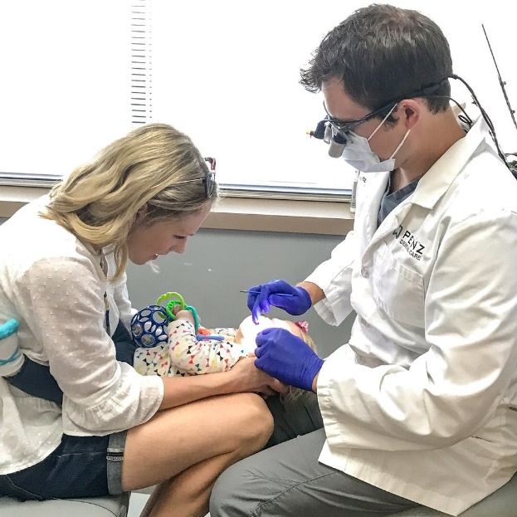
Community Dental Health Coordinators
Dr. Jane Grover
Senior Director – Council on Advocacy for Access and Prevention

Slide 2

JAMA: December 2012 CHW Commentary
“Patients need help with their social problems, connections to available resources in the community, transportation to medical visits, and translation of the increasingly complex language of medicine into terms they can understand and follow.”

Slide 3

How Complex is the “Dental” Language?
Pulpotomy
Periodontal Disease
Apicoectomy
Sealant
Cross Bite
Composite
Root Canal
Prophy

Slide 4

How to Connect a Patient to Care?
A) Hand them a sheet of paper and tell them to call one of the numbers on it
B) Connect them personally and follow up

Slide 5
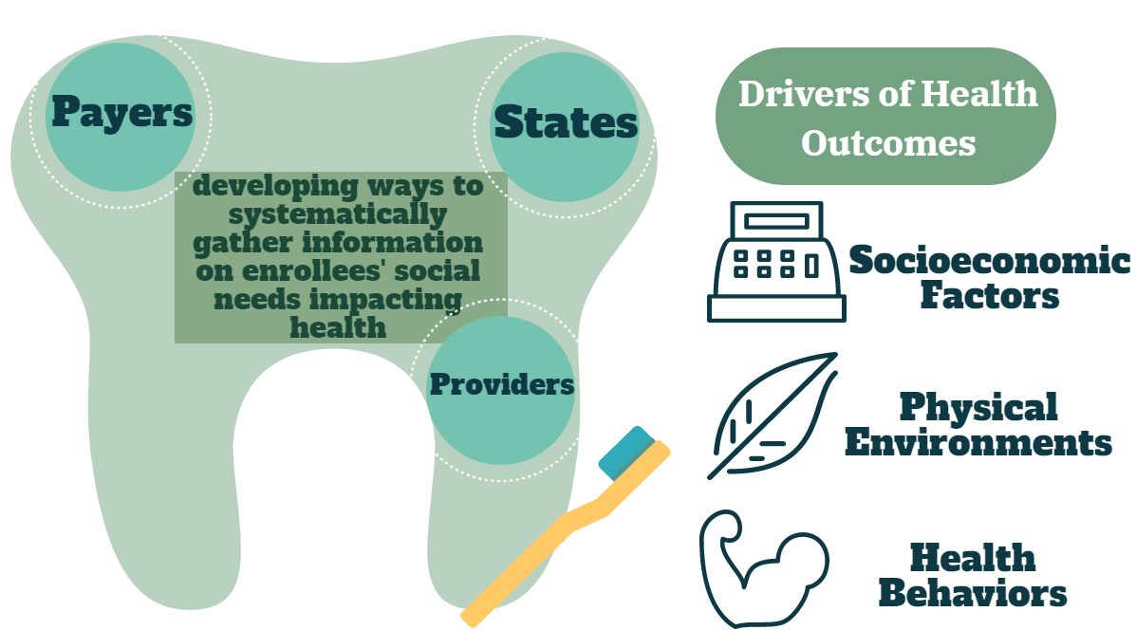
Identifying Social Needs

Slide 6
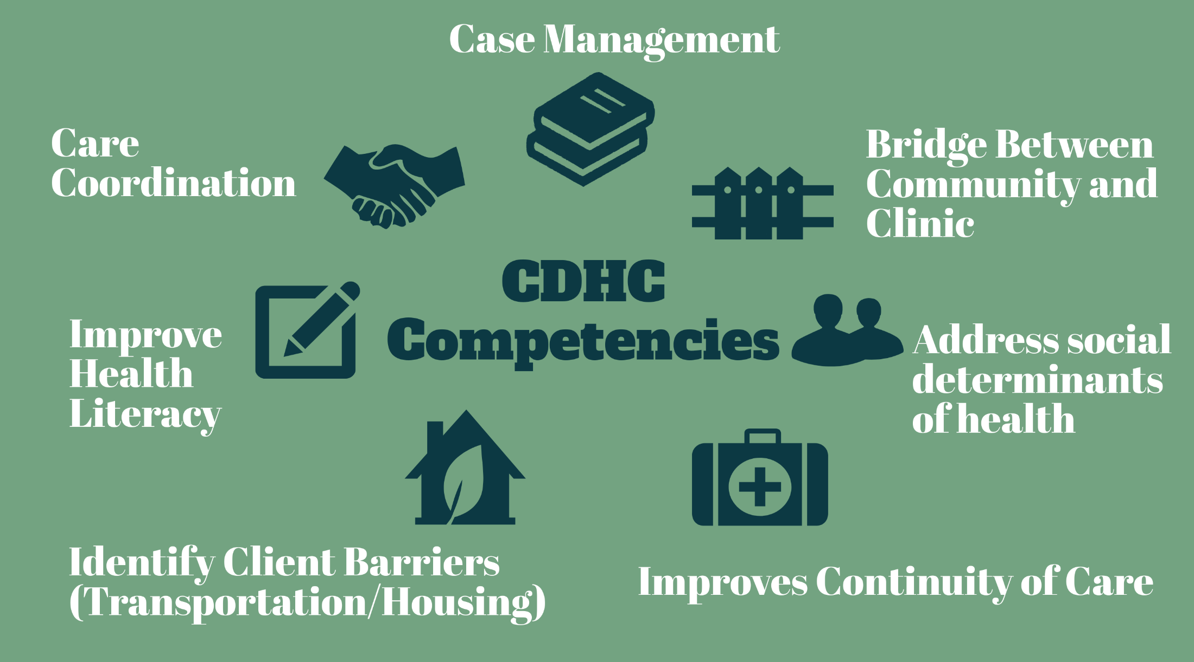
What a CHW skill set does for a TEAM

Slide 7
U.S. Bureau of Labor Statistics
Job Outlook:Overall employment of health education specialists and community health workers is projected to grow 17 percent from 2020 to 2030, much faster than the average for all occupations.
About 16,100 openings for health education specialists and community health workers are projected each year, on average, over the decade.

Slide 8


What is Driving the Demand ?
Growth will be driven by efforts to improve health outcomes and to reduce healthcare costs by teaching people healthy behaviors and explaining how to use available healthcare.

Slide 9
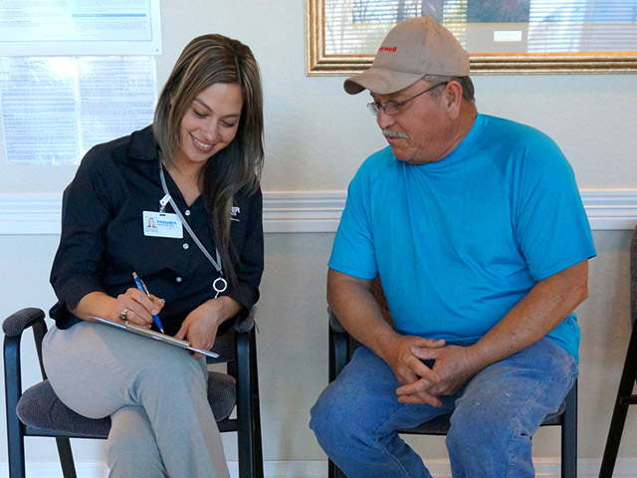
What Community Health Workers (CHW) Do
A CHW builds individual and community capacity by increasing health knowledge and self - sufficiency through outreach, community education, informal counseling and advocacy

Slide 10

Established Value of CHWs
The Center for Healthcare Strategies Jan 2020
“Recognizing and Sustaining the Value of Community Health Workers and Promotores” Special Report

Slide 11

What if a Dental Professional had CHW skills?

Slide 12

Who are CDHCs?
Dental “community health workers” who perform outreach, community education and preventive services as allowed by State Practice Acts
Dental professionals (hygienists or assistants) who work in settings, such as FQHCs, Tribal clinics, Head Start programs, or private dental practices

Slide 13
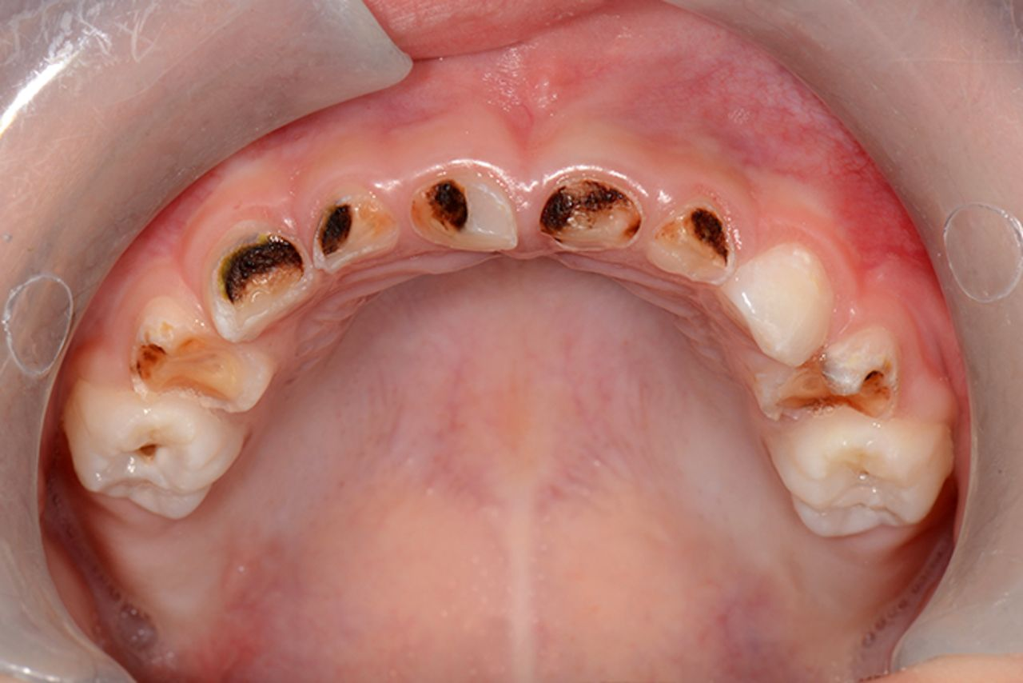
CHW Skill Set + Dental Skills
Knowledge of oral health delivery services and ability to converse with both medical / dental personnel
Knowledge of dental nomenclature, dental appointment types, and dental prevention strategies

Slide 14
Coordination of Care Value
Reduce broken appointments
Lower the “what happens next” anxiety
Medical knows what Dental is doing
Complicated Care = Navigation Need

Slide 15
Let’s Talk About the Curriculum / Program
Can be offered as CE or “stacked”
No royalty fee to ADA
Can be “sublicensed” to another school
Provides “value added” for graduates

Slide 16

CDHC Points to Remember
No change to a State Practice Act
Approximately 11-13 curriculum credit
hours to “stack” or offer as CE

Slide 17
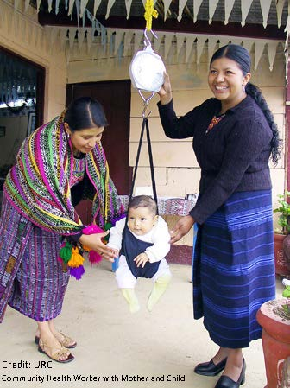
Online Modules Plus Some ZOOM
Community Mapping
Motivational Interviewing
Home Visit Strategies
Evaluating Credible Data
Being a “Change Agent”
Cultural Competence
Case Management

Slide 18

Program Time Commitment
3-4 Hours per week of reading / writing
Community Demonstration Project

Slide 19
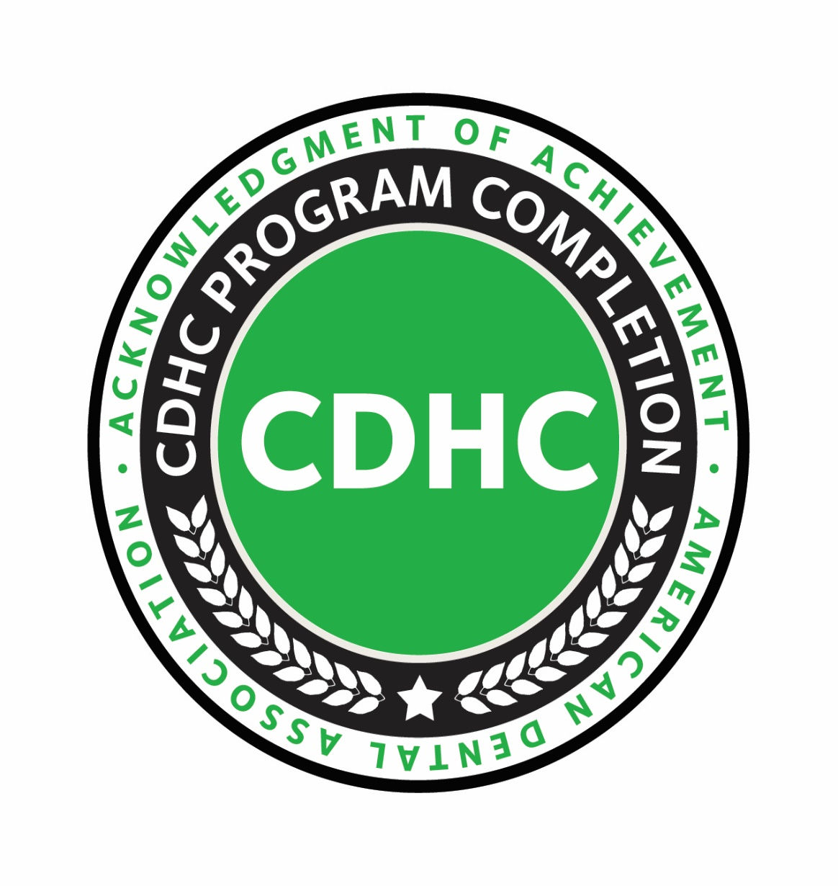
Certificate of Completion

Slide 20

Health Center Applicability
A North Carolina FQHC saw 80-100 new dental patients from a medical only site
Bassett FQHC established formal job description for a CDHC and utilizes one for hospital ED referral processes

Slide 21
Tennessee Update
Dental Assistant Serves as Link Between FQHC Medical Only Site and a Dental Home
“My being there one day per week has resulted in a 300% growth in patients coming from the health center”
3 Dental Assistants Working on Smile ON 60+ project with 15 dental charities across the state)
1137 seniors linked to care in 8 weeks

Slide 22
Hospital Department Applicability
Washington DC Hospital Patient Navigation
Miami Hospital Patient Case Manager
New York Hospital Systems Using CDHC Trained Professionals in Dental Patient Case Management

Slide 23

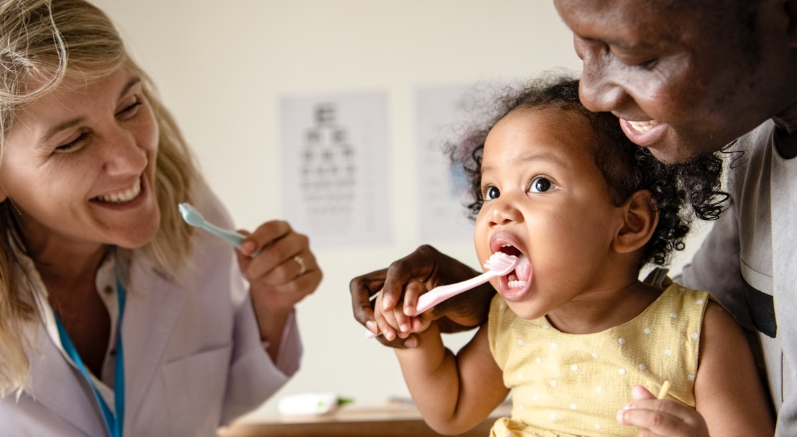
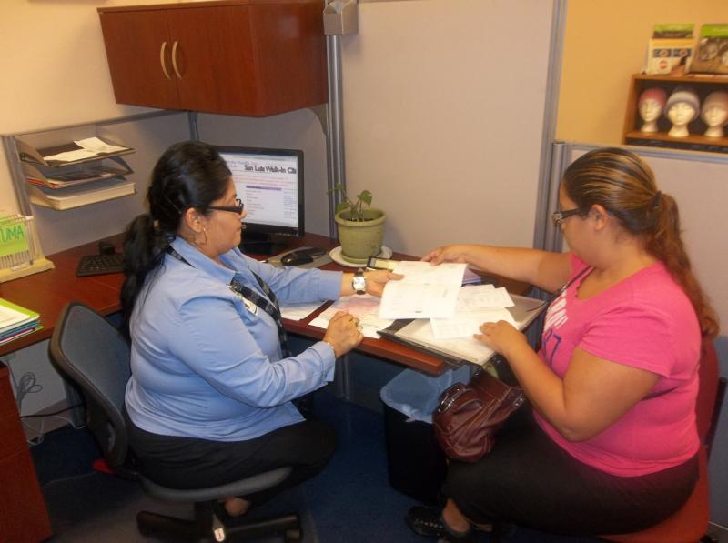
Internship Examples Which Grew Into More

Slide 24


Bringing Understanding of Dental Disease to Schools
501(c)3 Nonprofit Organization EIN 81-4460839

Slide 25
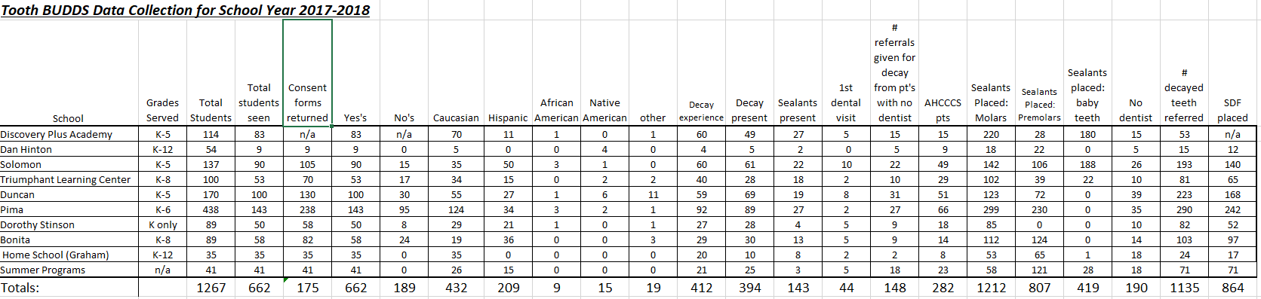
Solomon Elementary School Grades K-5
2017 2018
% of children with decay 69% 30%
# of teeth with decay 193 76

Slide 26
Alabama CDHC Internship = HRSA Grant
CDHC and UAB Faculty Member Improve Dental Student Experiences in Treatment of Young Children
Research Article in the Journal of Dental Education 2021
Improved Access, Prevention and Education

Slide 27
Internship Reflection
My internship has further sparked my interest in social determinants and health disparities. Knowing and understanding the barriers many patients face makes it understandable as to why it is difficult for them to maintain good health. In the future I hope to make the programs and create and initiate the policies that can provide everyone with access to great health.
The importance of any type of outreach or how important connecting with a patient can be. I had many patients who were thankful for my calls, those who expressed gratefulness with helping make their appointments, and those who benefitted off of one on one conversations.
My internship made me more aware of what skills I possess and am good at and what skills I need to work on more in order to become a better and more informed community health worker. I also acquired a lot of knowledge on oral health

Slide 28
Program Value in Graduate Words
Going to patients where they’re at otherwise they may never receive services
Gave me a broader perspective when I had to fill out a Medicaid application (as part of an assignment) that was very complex
  Understood language barriers / illiteracy
  I became more empathetic and started helping patients fill out their health histories when I saw them struggling

Slide 29
CDHC Training Site / Value Expansion
FQHC – Zufall Community Health Center
Dental School – University of West Virginia
Indian Health Service – Federal Agency
Case Management Code Reimbursement

Slide 30
Educational Sites (Partial List)
Schools in North Carolina (2)
Kentucky New Mexico
Ohio Arizona
Illinois (2)
Hawaii, Massachusetts, Iowa, California

Slide 31
CDHC in the Media
Helping veterans navigate care: Community Dental Health Coordinators pitch in, ADA News, 11/18/18
ADA CDHC program helps Chicago nonprofit get kids access to care, ADA News, 9/17/18
ADA visits Navajo Nation, where Community Dental Health Coordinators' work is in the spotlight, ADA News, 9/11/18
CDHC who started nonprofit recognized with research award, ADA News, 6/18/18
Dental hygiene students complete CDHC online certification, SIU News Blog, May, 2018
New Community Dental Health Coordinator Program in Chicagoland, Daily Herald, 3/22/18
ADA CDHC program instrumental in success of Arizona nonprofit, ADA News, 3/5/18

Slide 32

Community Dental Health Coordinator Program–
Your Career Expander and Extender!
Scan QR Code and enter
Password:
COMMUNITY2022
to access Verification of Attendance Certificate

Slide 33

Questions - Comments
Dr. Jane Grover
groverj@ada.org
Ms. Kelly Cantor
cantork@ada.org

